Slide 1
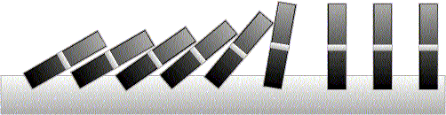
Mathematical Induction

Slide 2
This Lecture
Last time we have discussed different proof techniques.
This time we will focus on probably the most important one
– mathematical induction.
This lecture’s plan is to go through the following:
The idea of mathematical induction
Basic induction proofs (e.g. equality, inequality, property, etc)
Inductive constructions
A paradox

Slide 3
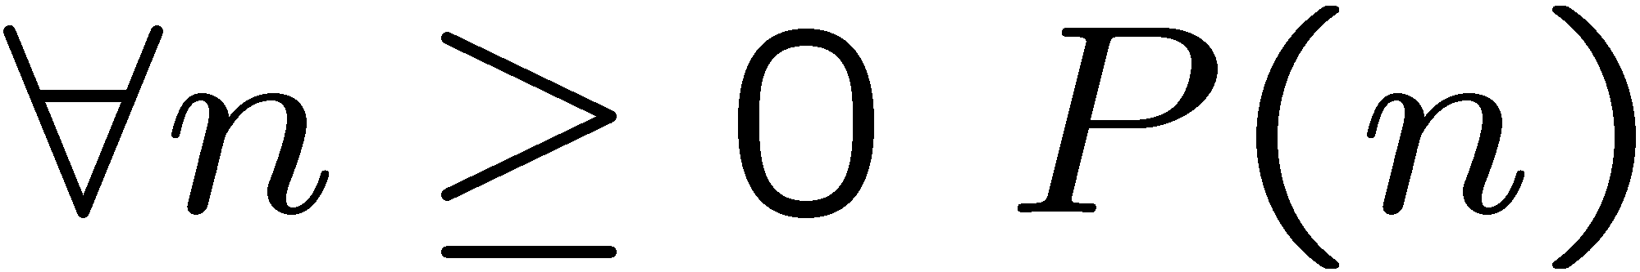
Proving For-All Statements
Objective: Prove
It is very common to prove statements of this form. Some Examples:
For an odd number m, m^{i} is odd for all non-negative integer i.
Any integer n > 1 is divisible by a prime number.
(Cauchy-Schwarz inequality) For any a₁,…,a_{n}, and any b₁,…b_{n}

Slide 4
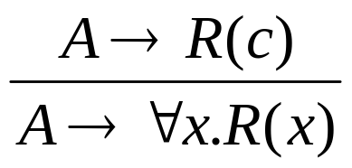
Universal Generalization
valid rule
providing c is independent of A
One way to prove a for-all statement is to prove that R(c) is true for any c,
but this is often difficult to prove directly
(e.g. consider the statements in the previous slide).
Mathematical induction provides another way to prove a for-all statement.
It allows us to prove the statement step-by-step.
Let us first see the idea in two examples.

Slide 5
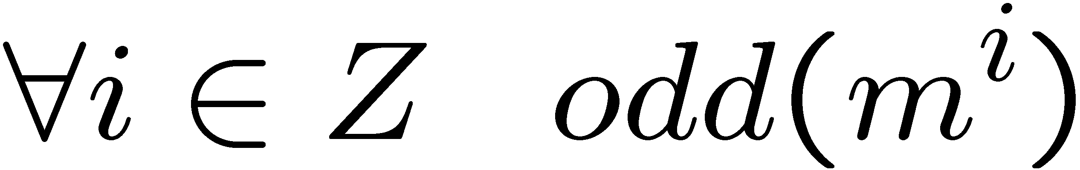
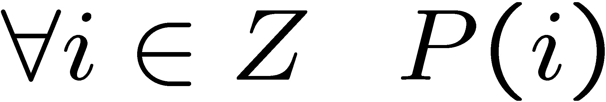
Odd Powers Are Odd
Fact: If m is odd and n is odd, then nm is odd.
Proposition: for an odd number m, m^{i} is odd for all non-negative integer i.
Let P(i) be the proposition that m^{i} is odd.
Idea of induction.
P(1) is true by definition.
P(2) is true by P(1) and the fact.
P(3) is true by P(2) and the fact.
P(i+1) is true by P(i) and the fact.
So P(i) is true for all i.

Slide 6
Divisibility by a Prime
Theorem. Any integer n > 1 is divisible by a prime number.
Let n be an integer.
If n is a prime number, then we are done.
Otherwise, n = ab, both are smaller than n.
If a or b is a prime number, then we are done.
Otherwise, a = cd, both are smaller than a.
If c or d is a prime number, then we are done.
Otherwise, repeat this argument, since the numbers are
getting smaller and smaller, this will eventually stop and
we have found a prime factor of n.
Idea of induction.

Slide 7
Idea of Induction
Objective: Prove
This is to prove
The idea of induction is to first prove P(0) unconditionally,
then use P(0) to prove P(1)
then use P(1) to prove P(2)
and repeat this to infinity…

Slide 8

The Induction Rule
0 and (from n to n +1),
proves 0, 1, 2, 3,….
P (0), ∀n∈Z P (n)P (n+1)
∀m∈Z P (m)
Much easier to prove with P(n) as an assumption.
Very easy to prove
induction rule
(an axiom)
The point is to use the knowledge on smaller problems to
solve bigger problems (i.e. can assume P(n) to prove P(n+1)).
Compare it with the universal generalization rule.

Slide 9
This Lecture
The idea of mathematical induction
Basic induction proofs (e.g. equality, inequality, property,etc)
Inductive constructions
A paradox

Slide 10
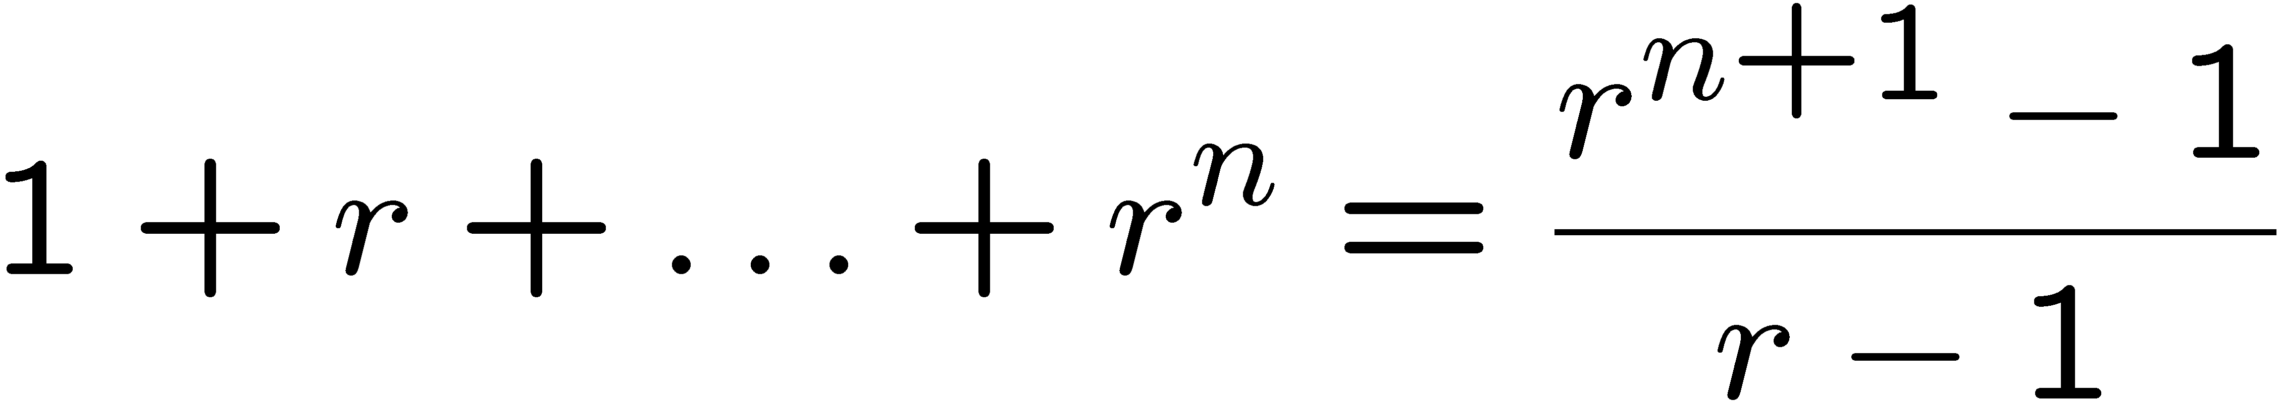
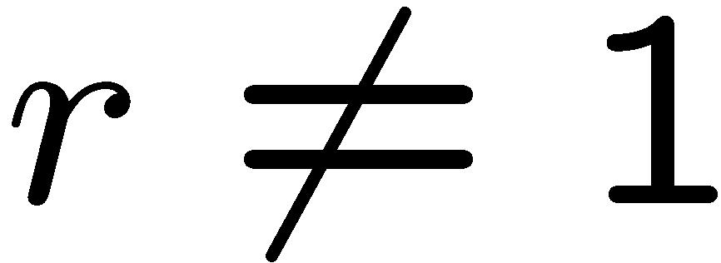
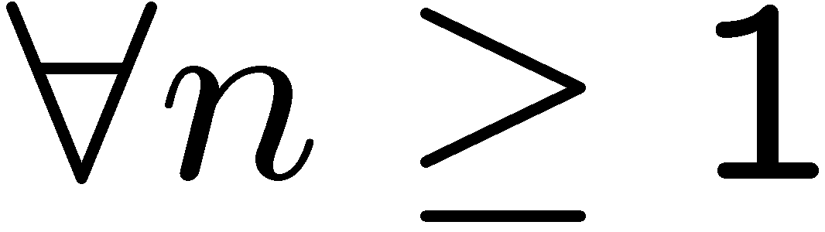
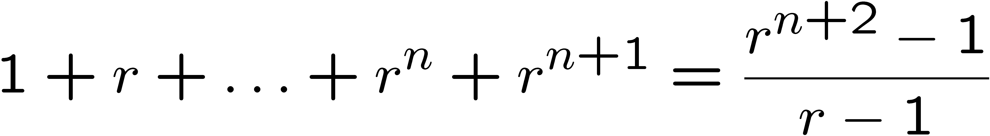
Proving an Equality
Let P(n) be the induction hypothesis that the statement is true for n.
Base case: P(1) is true
because both LHS and RHS equal to 1
Induction step: assume P(n) is true, prove P(n+1) is true.
That is, assuming:
Want to prove:
This is much easier to prove than proving it directly,
because we already know the sum of the first n terms!

Slide 11
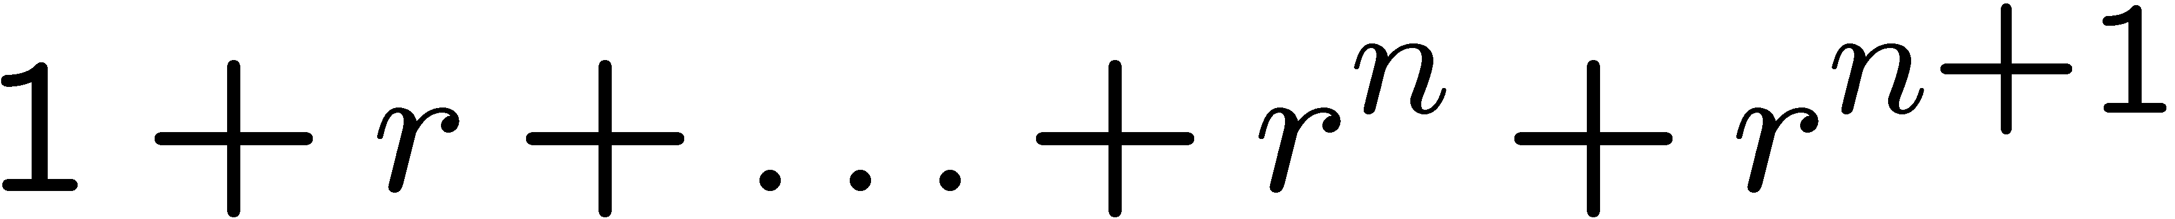
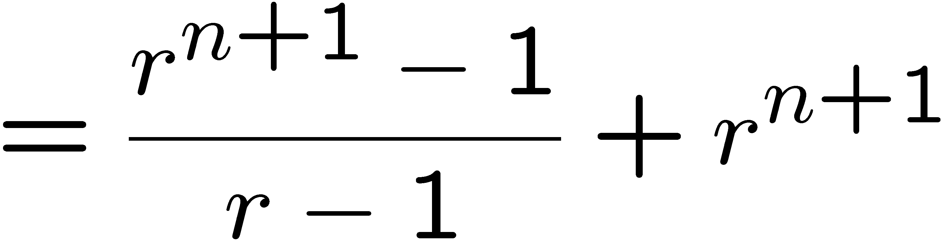
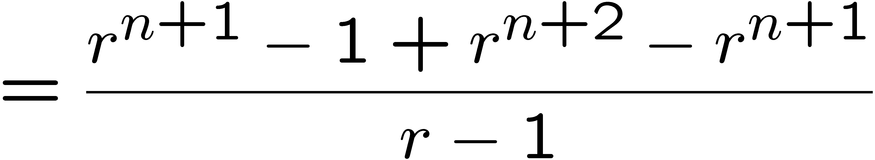
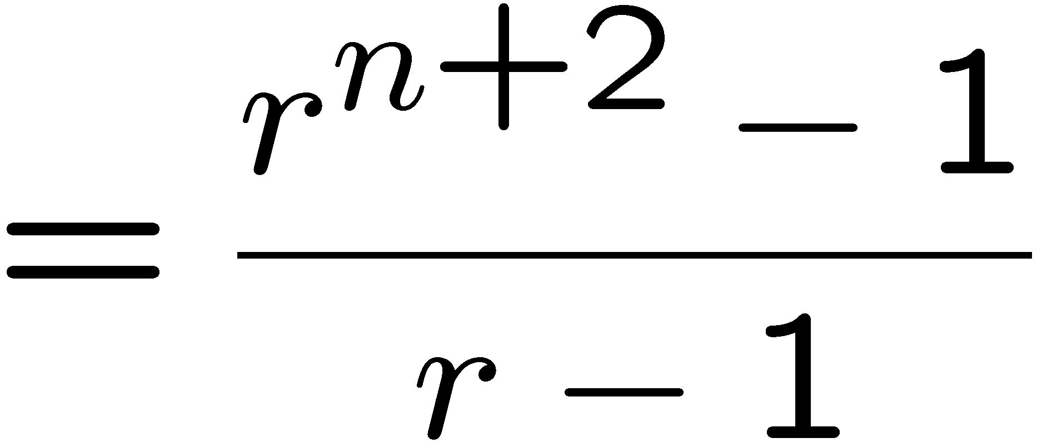
Proving an Equality
Let P(n) be the induction hypothesis that the statement is true for n.
Base case: P(1) is true
because both LHS and RHS equal to 1
Induction step: assume P(n) is true, prove P(n+1) is true.
by induction

Slide 12
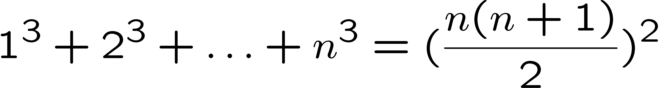
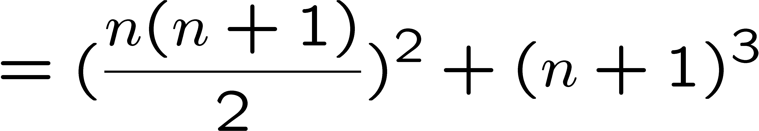
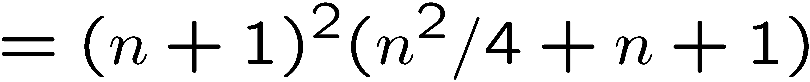
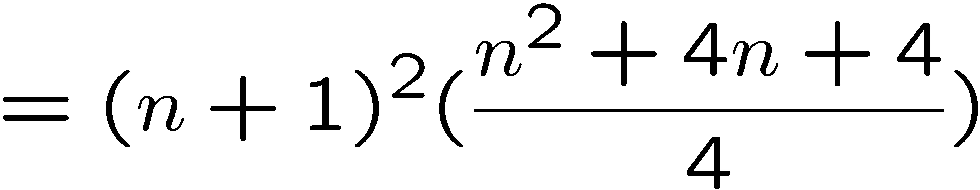
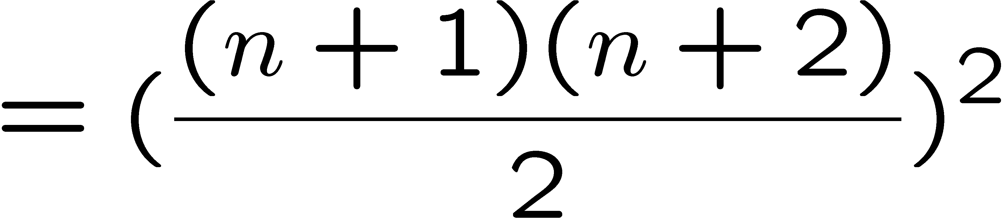
Proving an Equality
Let P(n) be the induction hypothesis that the statement is true for n.
Base case: P(1) is true
Induction step: assume P(n) is true, prove P(n+1) is true.
by induction

Slide 13
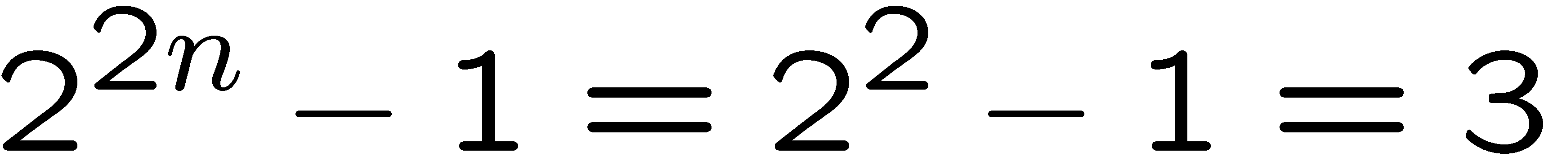
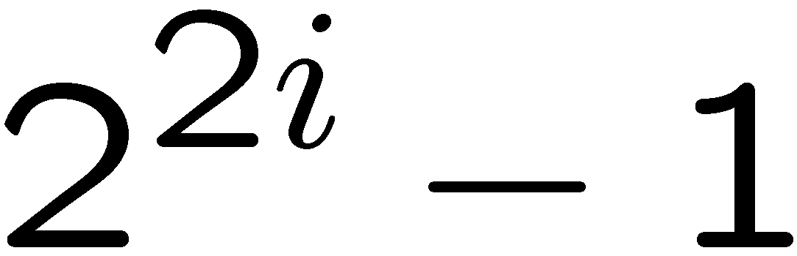
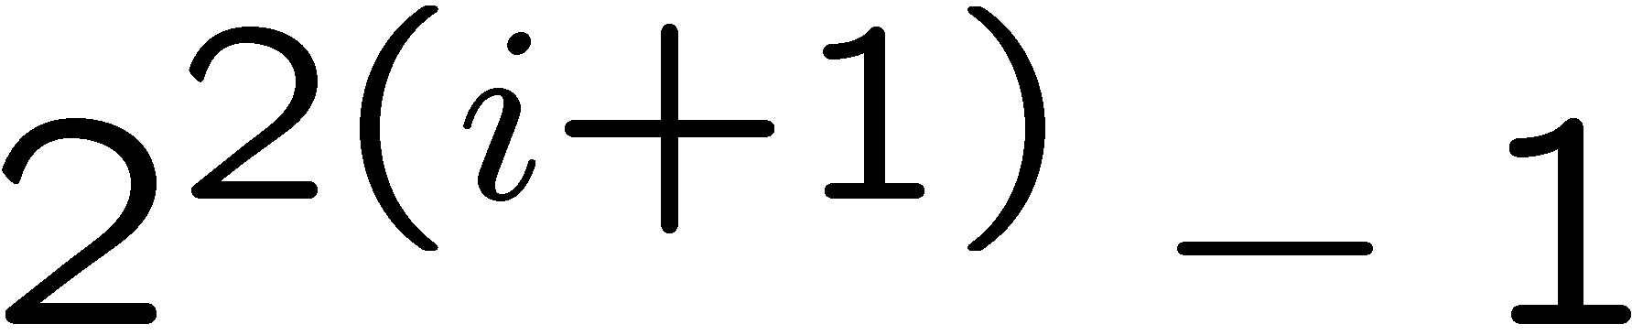
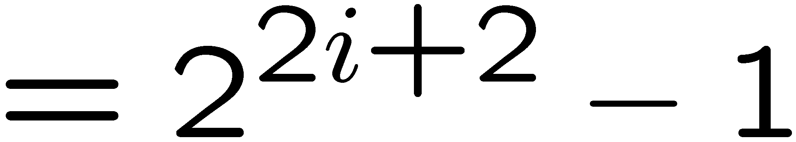
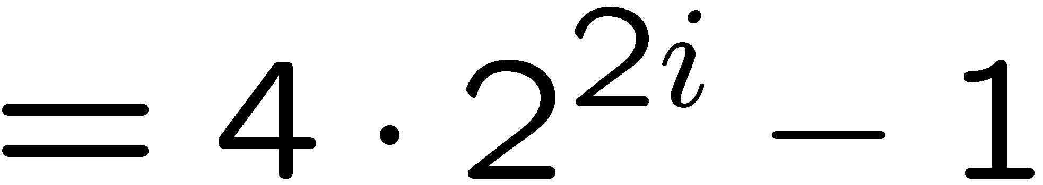
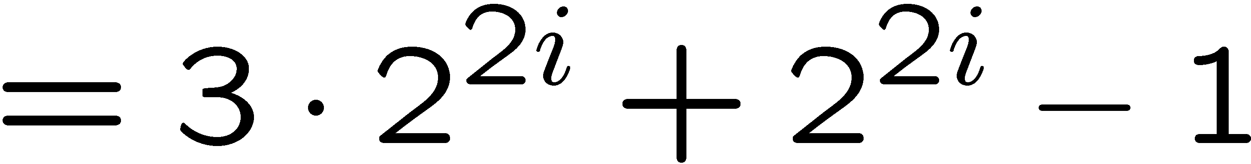
Proving a Property
Base Case (n = 1):
Induction Step: Assume P(i) for some i ≥ 1 and prove P(i + 1):
Assume
is divisible by 3, prove
is divisible by 3.
Divisible by 3
Divisible by 3 by induction

Slide 14
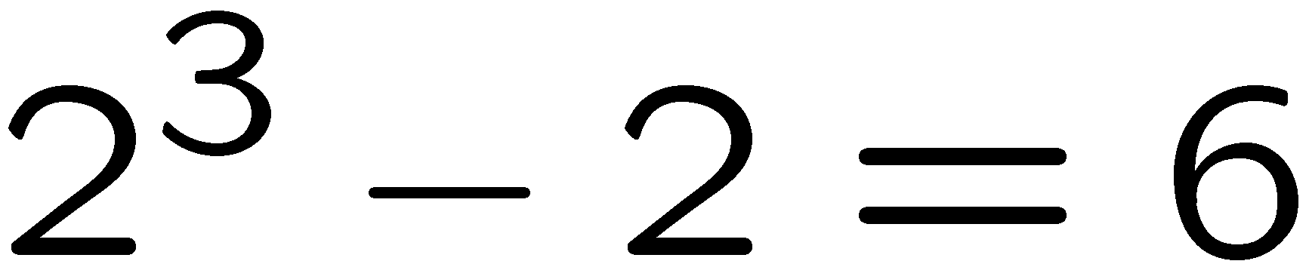
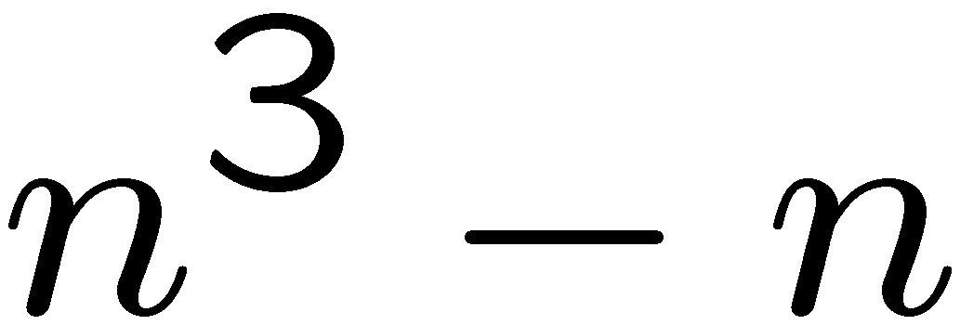
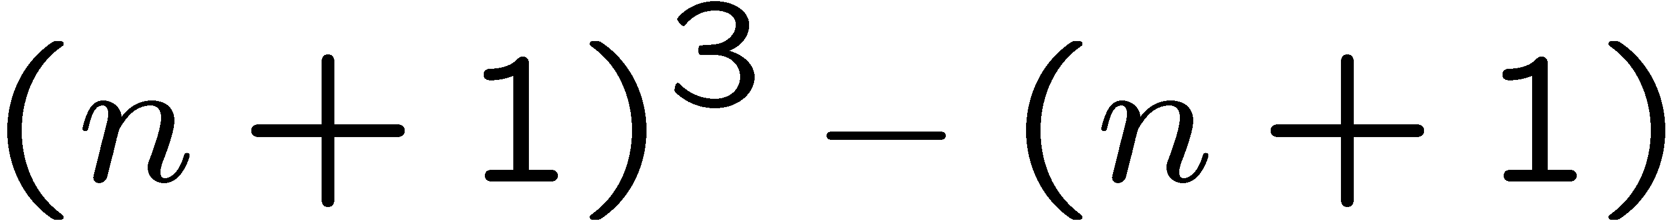
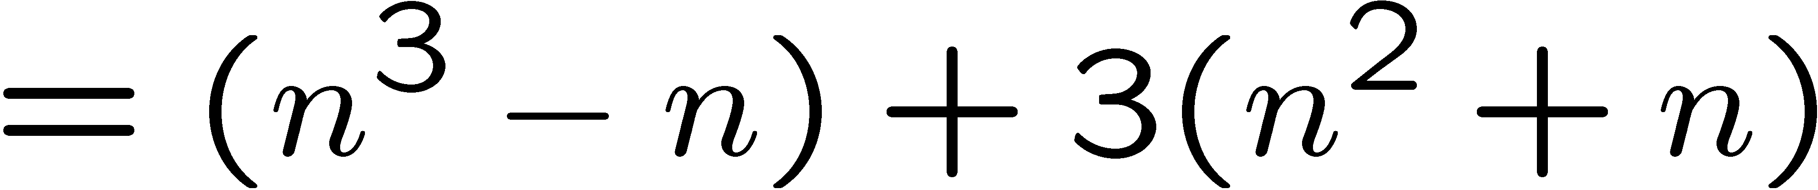
Proving a Property
Base Case (n = 2):
Induction Step: Assume P(i) for some i ≥ 2 and prove P(i + 1):
Assume
is divisible by 6
Prove
is divisible by 6.
Divisible by 6
by induction
Divisible by 2
by case analysis

Slide 15
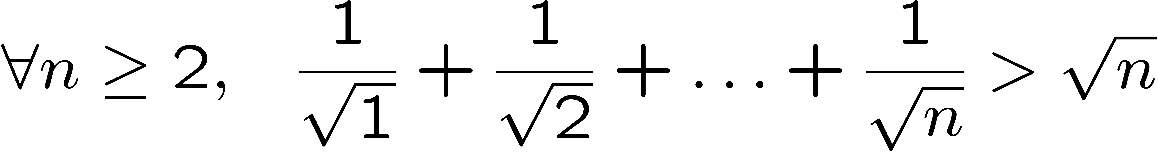
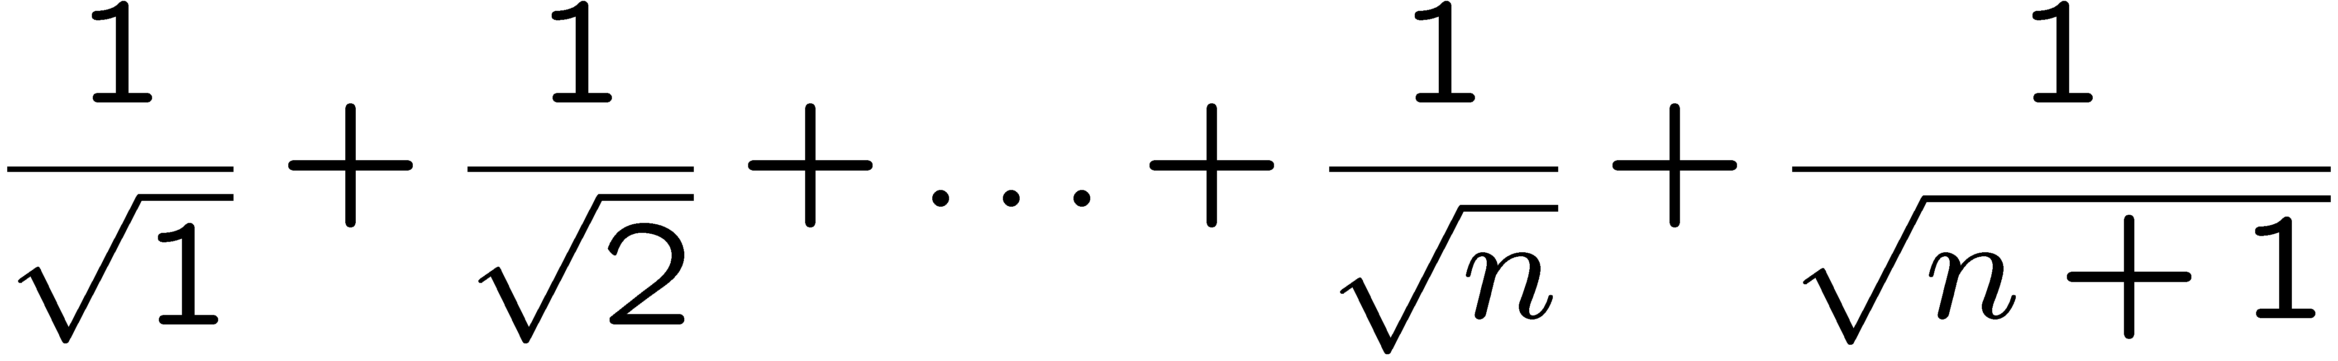
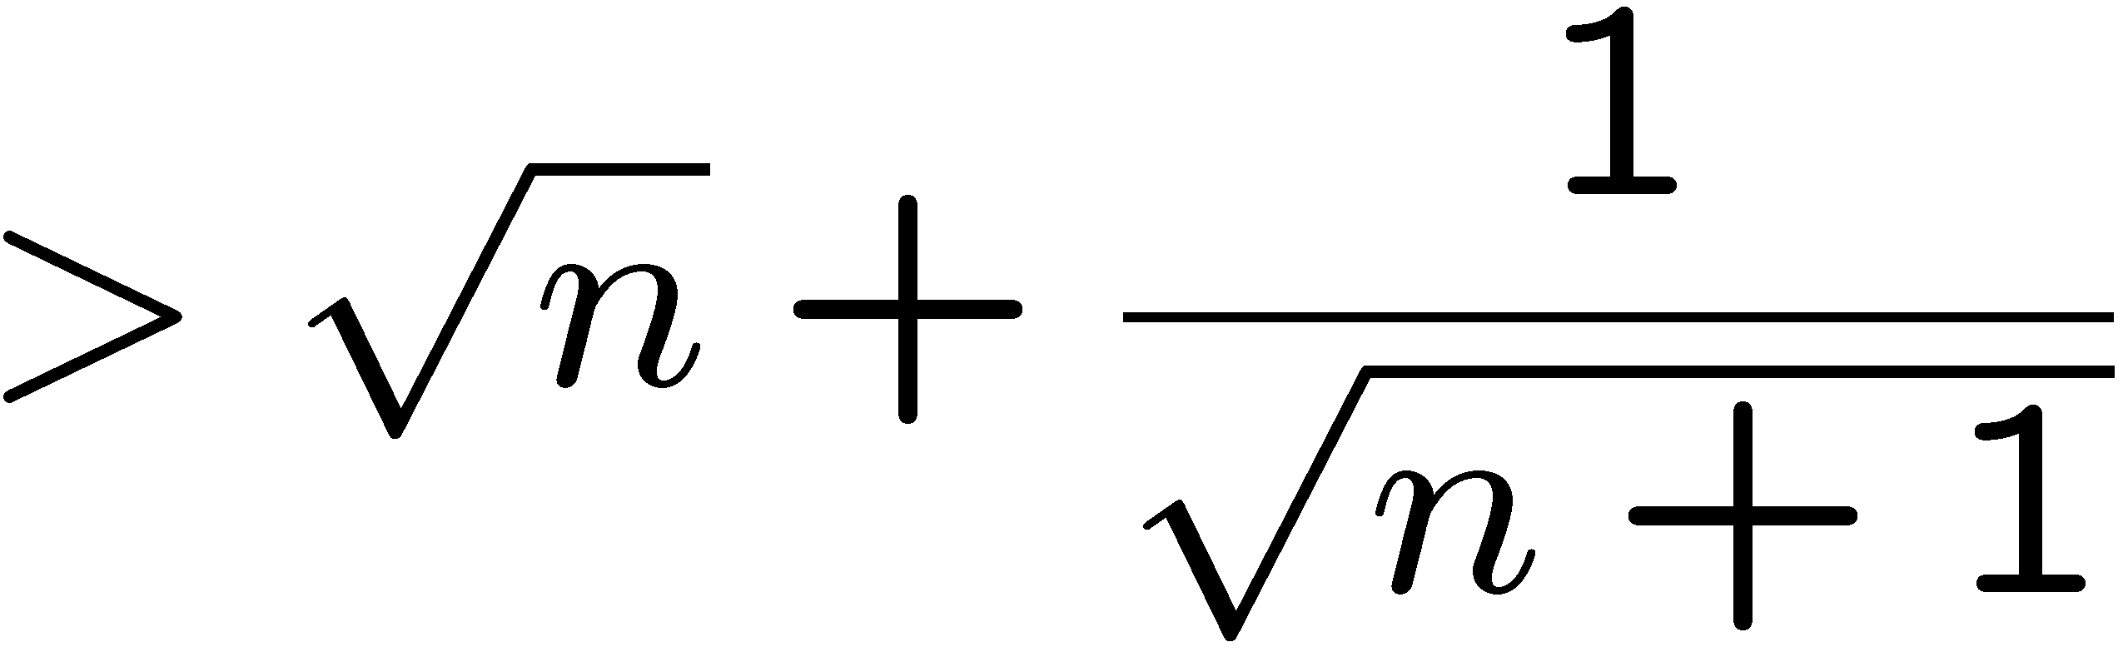
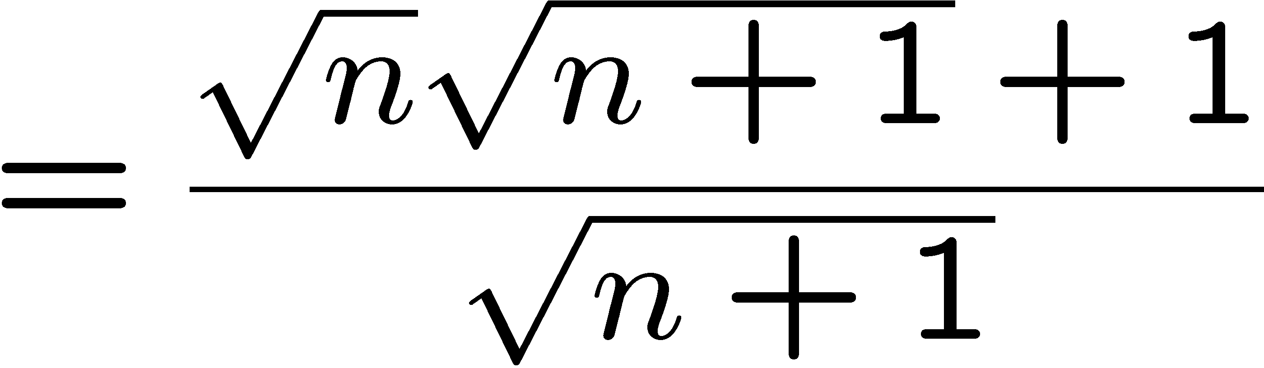
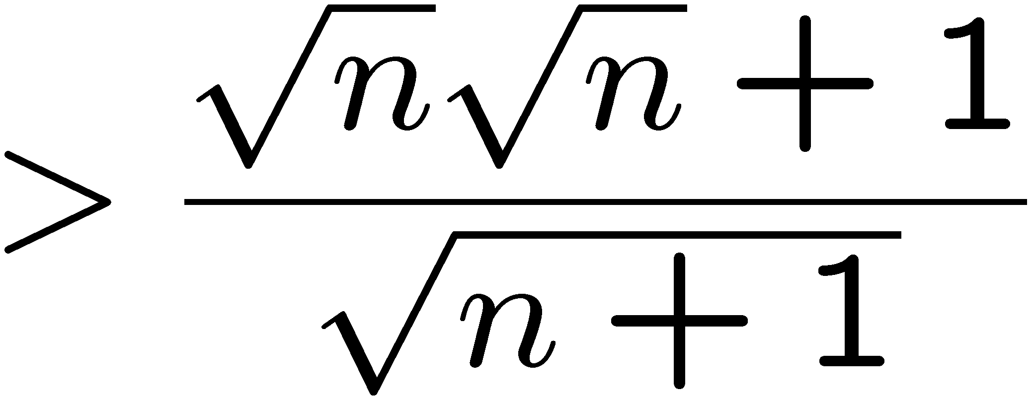
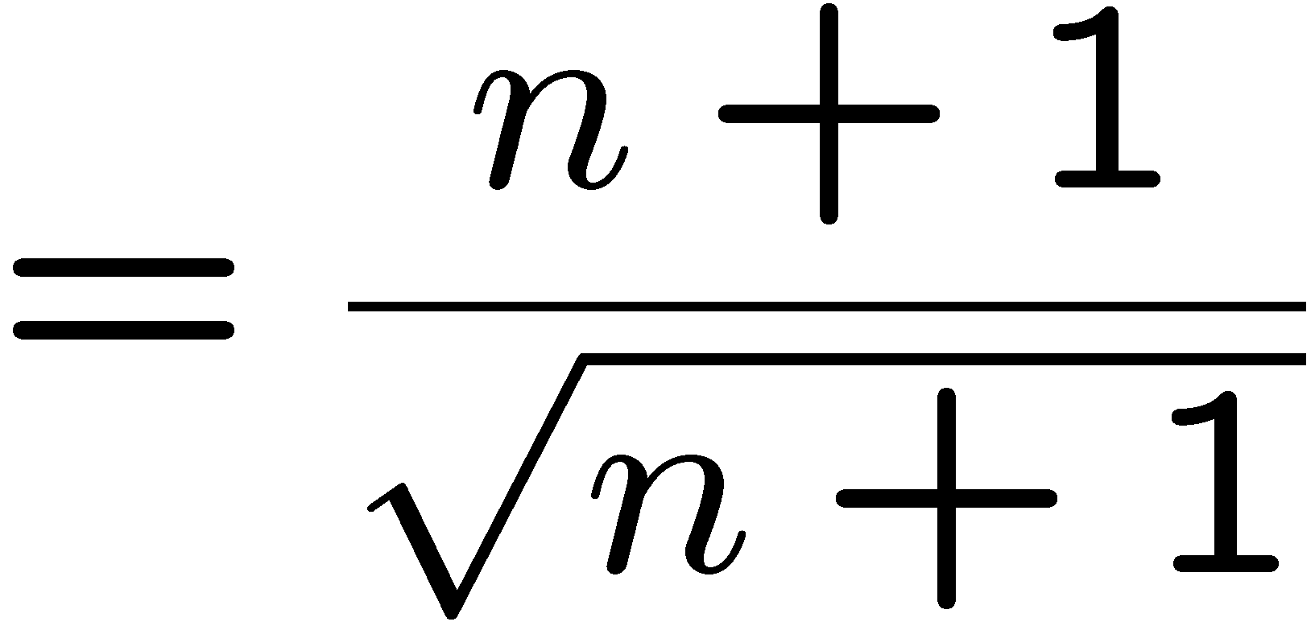

Proving an Inequality
Base Case (n = 2): is true
Induction Step: Assume P(i) for some i ≥ 2 and prove P(i + 1):
by induction

Slide 16
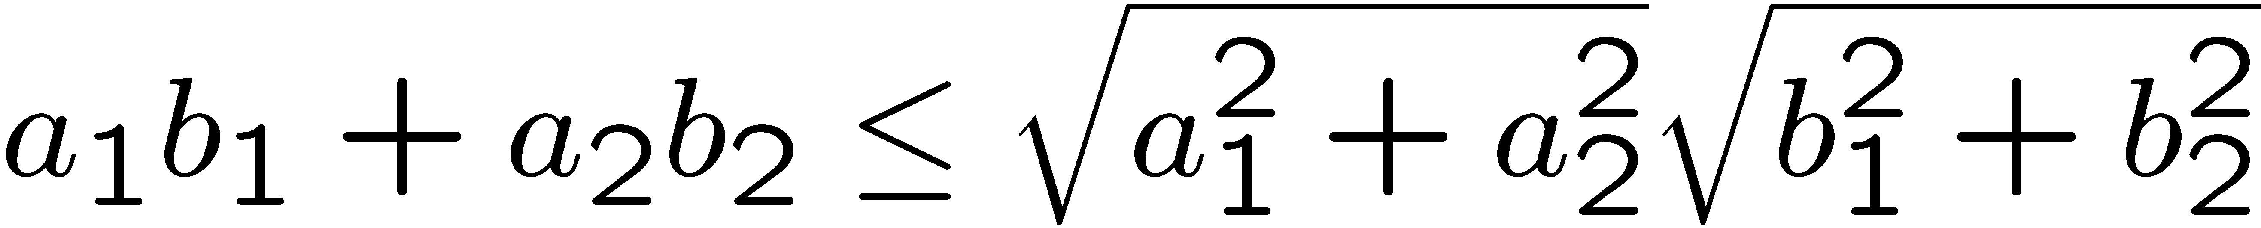
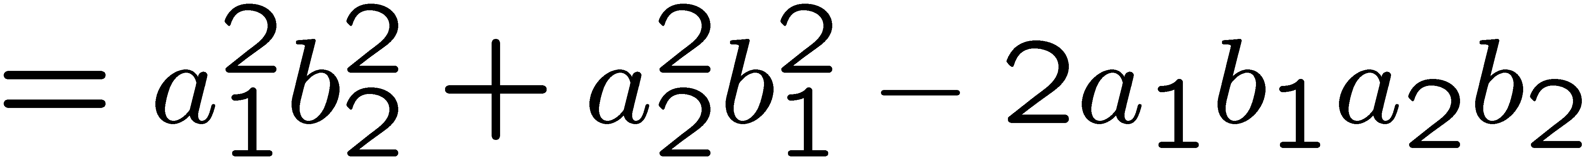
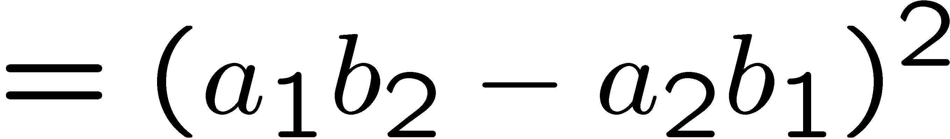
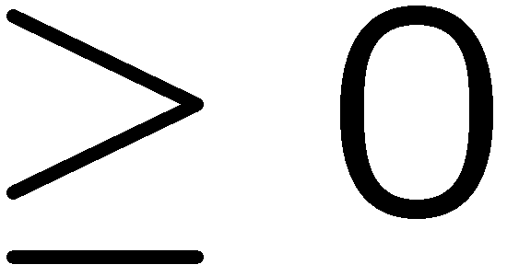
Cauchy-Schwarz
(Cauchy-Schwarz inequality) For any a₁,…,a_{n}, and any b₁,…b_{n}
Proof by induction (on n):
When n=1, LHS <= RHS.
When n=2, want to show
Consider

Slide 17

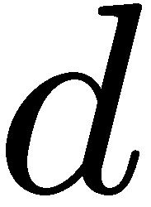
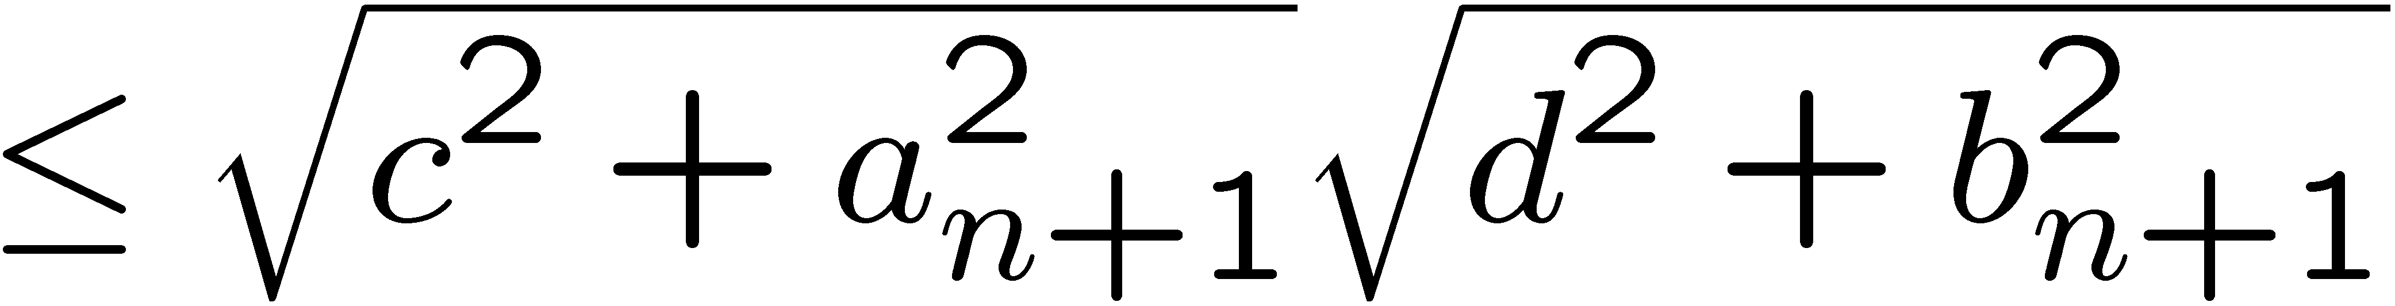
Cauchy-Schwarz
(Cauchy-Schwarz inequality) For any a₁,…,a_{n}, and any b₁,…b_{n}
Induction step: assume true for <=n, prove n+1.
induction
by P(2)

Slide 18
This Lecture
The idea of mathematical induction
Basic induction proofs (e.g. equality, inequality, property,etc)
Inductive constructions
A paradox

Slide 19
Gray Code
Can you find an ordering of all the n-bit strings in such a way that
two consecutive n-bit strings differed by only one bit?
This is called the Gray code and has some applications.
How to construct them?
Think inductively!
2 bit
00
01
11
10
3 bit
000
001
011
010
110
111
101
100
Can you see the pattern?
How to construct 4-bit gray code?

Slide 20
Gray Code
4 bit
3 bit
000
001
011
010
110
111
101
100
3 bit (reversed)
100
101
111
110
010
011
001
000
0
0
0
0
0
0
0
0
1
1
1
1
1
1
1
1
000
001
011
010
110
111
101
100
differed by 1 bit
by induction
differed by 1 bit
by construction
100
101
111
110
010
011
001
000
Every 4-bit string appears exactly once.
differed by 1 bit
by induction

Slide 21
Gray Code
n+1 bit
n bit
000…0
…
…
…
…
…
…
100…0
n bit (reversed)
100…0
…
…
…
…
…
…
000…0
0
0
0
0
0
0
0
0
1
1
1
1
1
1
1
1
000…0
…
…
…
…
…
…
100…0
differed by 1 bit
by induction
differed by 1 bit
by construction
100…0
…
…
…
…
…
…
000…0
Every (n+1)-bit string appears exactly once.
differed by 1 bit
by induction
So, by induction,
Gray code exists for any n.

Slide 22
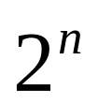

Puzzle
Goal: tile the squares, except one in the middle for Bill.

Slide 23

Puzzle
There are only trominos (L-shaped tiles) covering three squares:
For example, for 8 x 8 puzzle might tile for Bill this way:

Slide 24
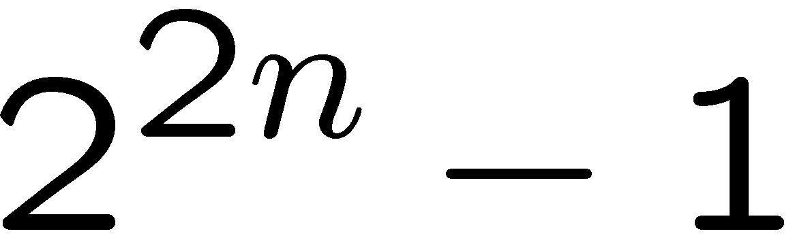
Puzzle
Theorem: For any 2^{n} x 2^{n} puzzle, there is a tiling with Bill in the middle.
(Did you remember that we proved
is divisble by 3?)
Proof: (by induction on n)
P(n) ::= can tile 2^{n} x 2^{n} with Bill in middle.
Base case: (n=0)
(no tiles needed)

Slide 25
Puzzle
Induction step: assume can tile 2^{n} x 2^{n},
prove can handle 2^{n+1} x 2^{n+1}.
Now what??
2
n
+
1

Slide 26
Puzzle
Idea: It would be nice if we could control the locations of the empty square.

Slide 27
Puzzle
Idea: It would be nice if we could control the locations of the empty square.
Done!

Slide 28
Puzzle
The new idea:
A stronger property
Prove that we can always find a tiling with Bill anywhere.
Theorem B: For any 2^{n} x 2^{n} plaza, there is a tiling with Bill anywhere.
Clearly Theorem B implies Theorem.
Theorem: For any 2^{n} x 2^{n} plaza, there is a tiling with Bill in the middle.

Slide 29
Puzzle
Theorem B: For any 2^{n} x 2^{n} plaza, there is a tiling with Bill anywhere.
Proof: (by induction on n)
P(n) ::= can tile 2^{n} x 2^{n} with Bill anywhere.
Base case: (n=0)
(no tiles needed)

Slide 30
Puzzle
Induction step:
Assume we can get Bill anywhere in 2^{n} x 2^{n}.
Prove we can get Bill anywhere in 2^{n+1} x 2^{n+1}.

Slide 31
Puzzle
Induction step:
Assume we can get Bill anywhere in 2^{n} x 2^{n}.
Prove we can get Bill anywhere in 2^{n+1} x 2^{n+1}.

Slide 32
Puzzle
Method: Now group the squares together,
and fill the center with a tile.
Done!

Slide 33
Some Remarks
Note 1: It may help to choose a stronger hypothesis
than the desired result (e.g. “Bill in anywhere”).
We need to prove a stronger statement, but in
return we can assume a stronger property in
the induction step.
Note 2: The induction proof of “Bill anywhere” implicitly
defines a recursive algorithm for finding such a tiling.

Slide 34
Hadamard Matrix
Can you construct an nxn matrix with all entries +-1 and
all the rows are orthogonal to each other?
Two rows are orthogonal if their inner product is zero.
That is, let a = (a₁, …, a_{n}) and b = (b₁, …, b_{n}),
their inner product ab = a₁b₁ + a₂b₂ + … + a_{n}b_{n}
This matrix is famous and has applications in coding theory.
To think inductively, first we come up with small examples.
1
1 -1

Slide 35
Hadamard Matrix
Then we use the small examples to build larger examples.
Suppose we have an nxn Hadamard matrix H_{n}.
We can use it to construct an 2nx2n Hadamard matrix as follows.
H_{n} H_{n}
H_{n} -H_{n}
It is an exercise to check that the rows are orthogonal to each other.
So by induction there is a 2^{k} x 2^{k} Hardmard matrix for any k.

Slide 36
Inductive Construction
This technique is very useful.
We can use it to construct:
- codes
- graphs
- matrices
- circuits
- algorithms
- designs
- proofs
- buildings
- …

Slide 37
This Lecture
The idea of mathematical induction
Basic induction proofs (e.g. equality, inequality, property,etc)
Inductive constructions
A paradox

Slide 38

Paradox
Theorem: All horses have the same color.
Proof: (by induction on n)
Induction hypothesis:
P(n) ::= any set of n horses have the same color
Base case (n=0):
No horses so obviously true!
…

Slide 39
Paradox
(Inductive case)
Assume any n horses have the same color.
Prove that any n+1 horses have the same color.
…
n+1

Slide 40
Paradox
(Inductive case)
Assume any n horses have the same color.
Prove that any n+1 horses have the same color.
Second set of n horses have the same color
…
First set of n horses have the same color

Slide 41
Paradox
(Inductive case)
Assume any n horses have the same color.
Prove that any n+1 horses have the same color.
…
Therefore the set of n+1 have the same color!

Slide 42
Paradox
What is wrong?
n =1
Proof that P(n) → P(n+1)
is false if n = 1, because the two
horse groups do not overlap.
Second set of n=1 horses
First set of n=1 horses
(But proof works for all n ≠ 1)

Slide 43
Quick Summary
You should understand the principle of mathematical induction well,
and do basic induction proofs like
  proving equality
  proving inequality
  proving property
Mathematical induction has a wide range of applications in computer science.
In the next lecture we will see more applications and more techniques.

